Slide 1

Инструменты правовой защиты российских лиц в «недружественных юрисдикциях»
Federal Legal Forum — 2026
Александр Хретинин, Orion

Slide 2
1. SBK ART LLC v Akin Gump Strauss Hauer & Feld LLP
United States District Court for the Southern District of New York
United States Court of Appeals for the Second Circuit
“This is cost of doing business as an international law firm”
1. Образец оформления сноски
2

Slide 3




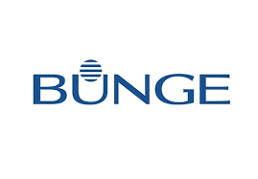


2. PJSC National Bank “TRUST” v Shishkhanov et al
BVI Commercial Court
“The Defendants should expect that if they used BVI vehicles to perpetrate their frauds, the BVI courts would hold their companies and them to account”
1. Образец оформления сноски
3

Slide 4
3. AO ALFA-BANK v Kipford Ventures Limited
The Eastern Caribbean Supreme Court in the Court of Appeal
“The learned judge’s decision and Orders thus pronounced and reasoned are accordingly plainly wrong. They amount to an error of law both on principle and as an erroneous exercise of discretion, in failing to pay due regard to the common law and to the Constitution ...
The learned judge accordingly failed to apply the law to the Bank’s case, affording a litigating party in the British Virgin Islands its fundamental right of access to justice. She committed an error which was plainly wrong in law, based on her misunderstanding of the Sanctions Regime as prescribed by SAMLA and as adopted in the British Virgin Islands”
1. Образец оформления сноски
4

Slide 5
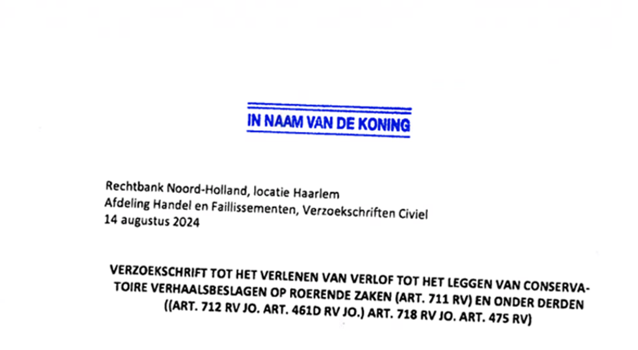
4. Uralkali v HAAS
Rechtbank Noord-Holland, locatie Haarlem, Jansstraat
1. Образец оформления сноски
5

Slide 6
5. Russian shareholder v Latvian Shareholder
Swiss Arbitration Centre
“This course of action cannot be reconciled with the duty of mutual cooperation that the Respondent owed to the Claimant under the Shareholders’ Agreement…
As the Latvian National Security Law only restricts voting rights of persons belonging to Russia and Belarus, without affecting the other rights of such shareholders – including the right to nominate a member for election to the Management Board – the Tribunal does not accept the Respondent’s argument that it was justified in replacing the members of the Management Board in order to “eliminate both direct and indirect influence by sanctioned parties””
1. Образец оформления сноски
6

Slide 7
СПАСИБО ЗА ВНИМАНИЕ
7

